Slide 1


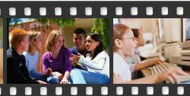
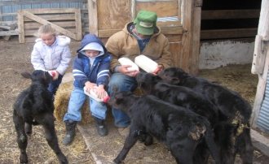
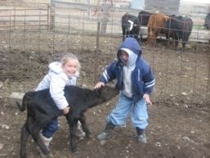
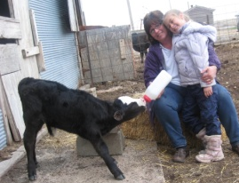
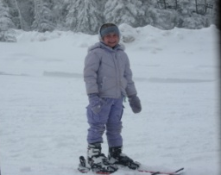
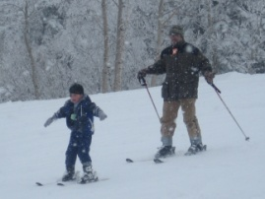
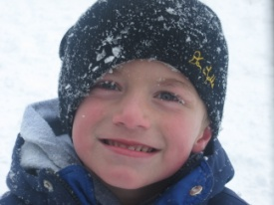
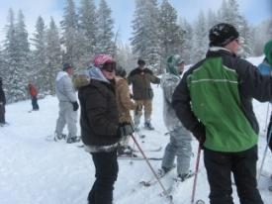
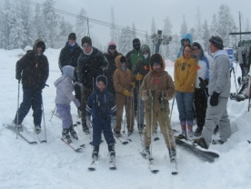
Digital Storytelling
Sandy Nightingale
Laptop Leaders’ Academy
June 1-3, 2009

Slide 2
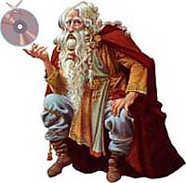
What is Digital Storytelling?
Digital Storytelling is the intersection between the age- old art of storytelling and access to powerful technology that is easy to learn and use.
“Digital Storytelling is the modern expression of the ancient art of storytelling. Digital stories derive their power by weaving images, music, narrative and voice together, thereby giving deep dimension and vivid color to characters, situations, experiences, and insights.”
~ Leslie Rule Center for Digital Storytelling

Slide 3
Digital Storytelling…
Encourages students to discover, develop, intensify, apply, and extend their creativity.
Gives students the opportunity to find and use a new and compelling voice.
Empowers students to create in a medium that is meaningful to them.
Provides a visual context for learning new information.
Addresses the different learning styles associated with a diverse student population.

Slide 4
Digital Storytelling…
Integrates reading, writing, speaking, listening, and viewing skills
Allows students to use their own voices to convey their thoughts.
Capitalizes on students' natural attraction to multimedia.
Utilizes 21st Century Skills

Slide 5
Building 21st-Century Skills
Creativity and inventive thinking
Critical Thinking and Problem Solving
Multiple intelligences
Higher-order thinking (lessons learned)
Information literacy
Visual literacy
Sound literacy
Technical literacy
Effective communication (oral, written, and digital)
Teamwork and collaboration
Project management
Enduring understandings

Slide 6
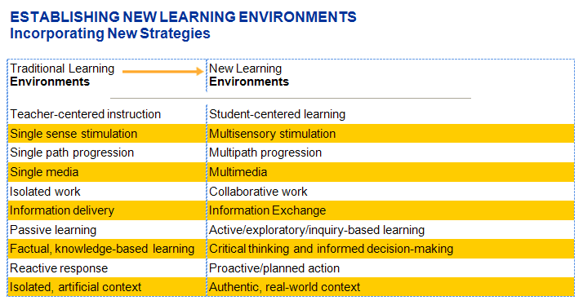
Incorporates New Learning Environments

Slide 7
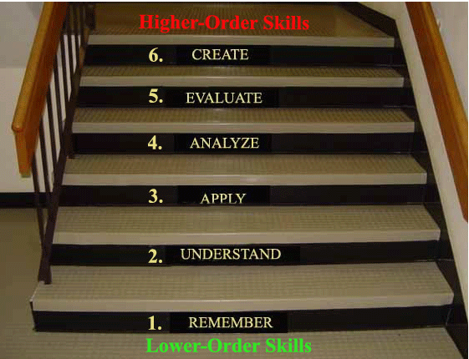
New Blooms Taxonomy
Higher-Order Thinking Skills

Slide 8
7 Elements of Digital Stories
Audience - Stories have a particular audience in mind.
Purpose - Stories are trying to accomplish a task (inform, educate, entertain, scare, persuade, educate, entertain, evoke emotion etc.)
Content - Content must be meaningful. Digital content adds to the story.
Voice - Stories are told from a specific perspective(s) and use the teller’s voice to enrich the story.
Technology - Technology is used to extend the story.
Connections - Good stories connect with the participants.
Economy - Stories tell enough to get the point across and no more.
Adapted from the Center for Digital Storytelling

Slide 9
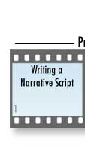


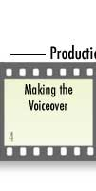


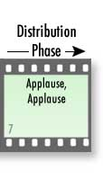
Phases of Digital Storytelling

Slide 10
Step #1-Brainstorm an Idea for Your Story
Consider audience and purpose.
Writing Prompts
  Search the Internet for interesting writing prompts
Picture Prompts
  Provide one picture to spark an idea for a digital story
  Provide a set of pictures (characters, setting, etc.) for students to use for their stories
    This works particularly well for younger students so they are able to spend more time on the story and less time focusing on finding pictures.
    They may add more pictures if needed.

Slide 11
Step #2-Develop a Script
Develop a Narrative Script
  No more than one double spaced page
  Go through the normal stages of writing-prewriting, rough draft, revising, editing, and final draft.

Slide 12
Step #3-Create a Simple Storyboard
What is a Storyboard?
  It is a place to plan out a visual story in two dimensions.
    The first dimension is time:
      What happens first, next, and last.
    The second is interaction:
      How does the voiceover (your story) interact with the images?
      How do visual transitions and effects help tie together the images?
      How does the voiceover interact with the musical soundtrack?
  In addition, a storyboard can be a notation of where and how visual effects, transitions, animations, compositional organization of the screen - will be used.
Storyboard Example #1
Storyboard Example #2

Slide 13
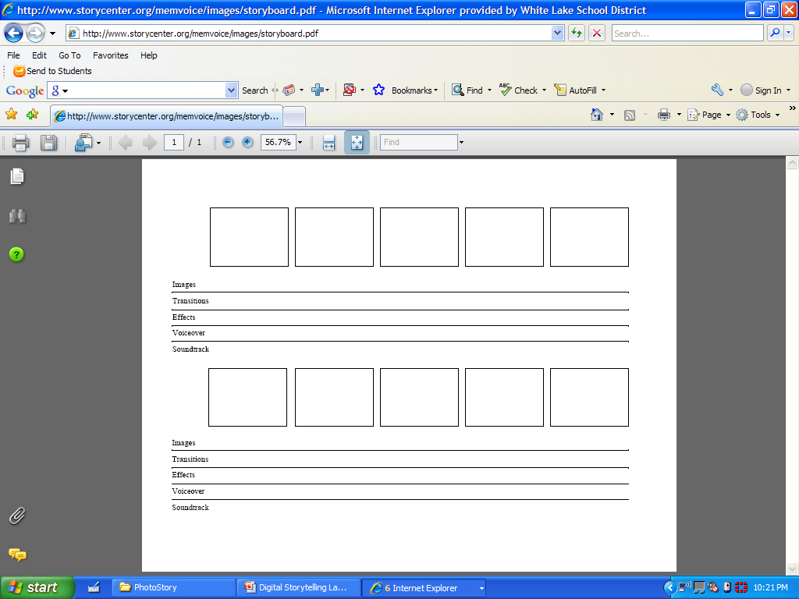
Create a simple storyboard to determine the sequence of the story.

Slide 14
Content and Storyboards First—Technology Second
Effective communication starts with an author having content that is worth sharing.
  Novelties such as flying words or spinning images sprinkled with a multitude of transitions, special effects, boinks, and bonks divert the attention of the viewer from the original message.
  After a digital storytelling is shared, it should be remembered for its soul, not the bells and whistles of technology.
  —Bernajean Porter

Slide 15
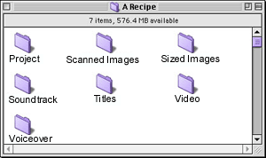
Step #4-Digitize Story Elements
Create organized files to store the story elements.
Collect images- Internet, scanned, SD cards, picture CDs, etc.

Slide 16
Step 5 – Put your Story Elements Together in Photo Story 3
Photo Story 3 – free download
Photo Story Tutorial

Slide 17
Pacing Your Narration
Pacing is the true secret of successful storytelling.
The rhythm of a story determines much of what sustains an audience’s interest.
  A fast-paced movie with many quick edits and upbeat music can suggest urgency, action, nervousness, exasperation, and excitement.
  Conversely, a slow pace will suggest contemplation, romanticism, relaxation, or simple pleasures.

Slide 18
Pacing Narration (cont.)
Changing pace, even in a short digital story, is very effective. Our narrative can have starts and stops, pauses, and quickly spurted phrases.
You can always change music tempo to build a sense of action or release.
Moving from a panning effect on a still image that slowly stretches out our concentration, followed by a burst of images in staccato succession, catches and holds our interest.

Slide 19
Pacing Narration (cont.)
“Good stories breathe. They move along generally at an even pace, but once in a while they stop. They take a deep breath and proceed. Or if the story calls for it they walk a little faster, and faster until they are running, but sooner or later they have to run out of breath and stop and wheeze at the side of the road. Anything that feels like a mechanical rhythm, anything that does not allow for that pause, to let us consider what the story has revealed, soon loses our interest. Again, trust your own sense of what works. Everyone moves at his or her own pace.”
~Center for Digital Storytelling

Slide 20
THE POWER OF SOUND
The sudden opening of the door becomes the prelude to disaster, when the swelling treble of orchestrated strings calls out suspense to our ears.
A sweetly flowing melody over two people looking at each other for the first time signals that these are the romantic characters we will be following in the plot.

Slide 21
Music
We know:
  upbeat music means happy endings
  slow and tremulous music means sadness is forecast
  fast music means action
  heroic music means battles and victorious heroes are likely
Instrumental music, whether it’s classical, folk, jazz, or ambient, is often better suited than lyrical music to the style and meaning of the story’s text and visual narratives.

Slide 22
Copyright
Using one’s own voice and existing personal material has the advantage of being copyrighted by you as the author.
By using other's music, you are also likely crossing into the territory of deciding what should be the appropriate fair use of the copyrighted material.
  Put simply, if you are going to make money directly or indirectly by the presentation or distribution of the piece you have created, then you should have the composer's permission to use the music.
Fortunately, numerous companies have developed copyright-free music collections and software to assist you in designing a soundtrack that is wholly yours.
Click here for a copyright guide for educators.
Creative Commons Handout

Slide 23
Read Education World's five-part series on copyright, fair use, and new technologies:
Copyrights and Copying Wrongs
Is Fair Use a License to Steal?
Copyright Law and New Technologies
Applying Fair Use to New Technologies
District Liability and Teaching Responsibility

Slide 24
Free, Royalty Free, and Creative Commons
Free
  No Cost
Royalty Free
  Unlimited use. When you license an RF image, you can use it in any application, for as long as you like, in as many different projects as you like.
  Creative freedom. You can crop, manipulate and combine royalty-free images to suit your project needs.
Creative Commons
Watch "Wanna Work Together" which provides an excellent overview of Creative Commons licensing.

Slide 25
Credit Your Sources
Take time to cite your sources with “rolling credits” at the story’s end as well as adding any acknowledgements you want to make.

Slide 26
Publishing
Applause! Applause!
What joy to finish a digital story! There is much to celebrate. We are finally officially StoryKeepers!
There are many ways to publish.
  Exporting to email
  Web publishing
  Exporting stories to DVD format
  Porting your movie to Bluetooth enabled cell
And now the digital story lives happily ever after . . . literally a living artifact that each storyteller now leaves as a personal legacy to others.

Slide 27
Tools for Digital Storytelling
Photo Story 3 for Windows
You can use Photo Story 3 for Windows to create visually compelling and fun stories using your pictures and music. This article walks you through the basics of creating a photo story and shows you how easy and fun it can be! Download Photo Story 3
Windows Movie Maker
Online directions for making movies effortlessly
Comparison Chart for MovieMake, Photo Story, and PowerPoint

Slide 28
Examples:
1984 Multimedia Project Lesson Plan
Ordinary Heroes Everywhere Digital Story
A Trip to the Moon Digital Story
Indian Prairie School Digital Stories Digital Stories
Center for Digital Storytelling Examples and Resources
Recipe Digital Story
Winnepeg Schools Digital Stories Digital Stories
Maricopa Center for Learning and Instruction
Digital Story Examples
The American Dream
  Great example of Use of Music and voice expression to add to the mood of the story!
How the Challenger Explosion Encouraged Me to Draw Digital Story
Hollywood and the “Old South Myth”- Digital Story on Slavery

Slide 29
Sites Devoted to Movie Making in the Classroom
Digital Video in Education
Digital Video Project Ideas listed here focus on educational styles.
Digital Storytelling in Scott County Schools

Slide 30
Apple Learning Interchange
Math Movie Minute
Poetry in Motion
  Students find pictures to illustrate a poem and narrate the poem while the pictures play in the background.
Open Ended Questions
  Can a cockroach survive on Mars? Who would survive better in Egypt, Greeks or Aztecs? Working in teams, students develop an open-ended question. They then use the Internet and other resources to research the topic and come to a conclusion based on the data they find.
Properties of Matter
A Day With Fractions

Slide 31
Resources
Images
  Pics4Learning
  FreeFoto
  Free Images
  http://www.altavista.com/image/default
  http://www.google.com/imghp?hl=en&tab=wi&q
  An Adventure of the American Mind (from the Library of Congress)
  http://www.flickr.com/
  http://calphotos.berkeley.edu//about.shtml
  25 Free Stock Photo Sites
  Microsoft Office Online

Slide 32
Resources
Sound
  Soundzabound (cost)
  Sounddogs
  SmartSound
  Super Duper Music Looper
  http://www.freeplaymusic.com/
  http://www.partnersinrhyme.com/
  http://www.artsandmusicpa.com/music_pages/soundfiles.htm
  http://creativecommons.org/audio
  http://www.a1freesoundeffects.com

Slide 33
Additional Resources:
Digital Storytelling Cookbook and Traveling Companion
Digital Storytelling Network (Australia)
Digital Storytelling Project (England)
Digital Storytelling Resources
More Digital Storytelling Resources
Digital Storytelling Resources for Educators
Integrating Digital Storytelling into the Classroom
http://www.callofstory.org/
http://www.teachingteachers.com/index.htm
  http://www.coe.uh.edu/digital-storytelling/tools.htm

Slide 34
Resources (cont.)
Digital Storytelling Web Sites
Digital Storytelling Finds Its Place in the Classroom
http://www.microsoft.com/windowsxp/using/digitalphotography/PhotoStory/default.mspx
http://www.dtc.scott.k12.ky.us/technology/digitalstorytelling/ds.html
http://www.digitales.us/index.php

Slide 35
Multimedia Projects
http://maps.google.com/maps/ms?hl=en&ie=UTF8&lr=lang_en&oe=UTF8&msa=0&msid=105419746244613302539.000457bcf641a671d1fc7 Website that combines Google Maps with movies made by St. Thomas School's 5th grade exploration of the Native American' lifestyle before Columbus ***Excellent
http://conference2009.tie2.wikispaces.net/Visual+Poetry
http://www.dtc.scott.k12.ky.us/technology/digitalstorytelling/studentstories.html

Slide 36
Musical Multimedia Projects
Don't Laugh at Me
This is the song “Don’t Laugh at Me” telling a story with pictures.
“We Didn’t Start the Fire”
Billy Joel (reportedly) wrote this song after overhearing a child say that he felt sorry for “older people” like Billy Joel because no “history” happened in their lifetime, that NOW (or the time the song was written) was going to be the world’s most historical time period. The comment got to Billy Joel so much that he sat down and wrote this to prove that his lifetime has been FULL of history.
Historical Events in the song
An Amazing Multimedia Prayer
The song “Prayer to Saint Francis” in pictures

Slide 37
More Multimedia Projects
Public Service Announcement
Father Involvement - PSA
Movie Describing Characters, Setting, etc. of the novel
All Quiet on the Western Front
Digital Book Reports
Danny's Tornado book report
Lightning Book Report

Slide 38
Permission/release forms for students and teachers
Student Release/Permission
Teacher Release/Permission
Digital Storytelling Rubric
Sample Classroom Progress Chart for Digital Storytelling Progress

Slide 39
Cool Free Technology Resources
http://bighugelabs.com/flickr/
  Use your photos to make motivational posters, pop art, magazine covers, mosaics, puzzles, collages, framed photos, calendars, bead art, trading cards, CD covers, cubes, etc
http://www.wordle.net/
  Wordle is a toy for generating “word clouds” from text that you provide. The clouds give greater prominence to words that appear more frequently in the source text. You can tweak your clouds with different fonts, layouts, and color schemes. The images you create with Wordle are yours to use however you like. You can print them out, or save them to the Wordle gallery to share with your friends.
http://www.picnik.com/
  Picnik makes your photos fabulous with easy to use yet powerful editing tools. Tweak to your heart’s content, then get creative with oodles of effects, fonts, shapes, and frames.
  It's fast, easy, and fun.
http://fotoflexer.com/
  Fofoflexer is a free online image editor. Add effects, shapes, text, doodles, distortions, layers, retouches, as well as more advanced editing.

Slide 40
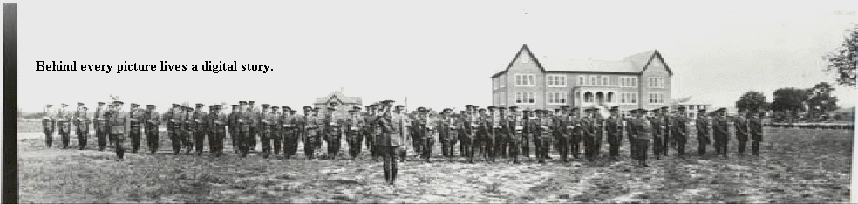
Thanks for Coming!
I hope you learned something from this session that you can take back and use in your classroom.
Don’t be discouraged! It takes more time at the beginning, but the more you work at it, the easier and less time consuming it becomes.
Remember…..

