Slide 1
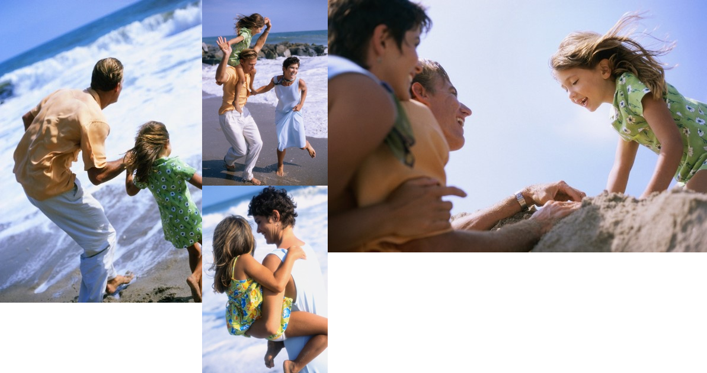
The Bowler’s Hawaiian Adventure
John, Amy and Katie having fun in the sun!

Slide 2
The Process
Plan
Decide “where” to go
Decide “when” to go
Save
Determine how much you need
Start putting it away
Enjoy
Buy the tickets
Sit back and relax

Slide 3
Planned Activities
Day | Activity | Location
Sunday | Traveling | Honolulu Airport
Monday | Beach | Ala Moana Beach Park
Tuesday | Shopping | Ala Moana Center
Wednesday | Beach | Waikiki Beach
Thursday | Dinner Cruise | Star of Honolulu
Friday | Beach | Haleiwa
Saturday | Traveling | Honolulu Airport

Slide 4
Beach
Shop
Flying a kite
Hat stand
Cruise
Our ship

Slide 5
