Slide 1
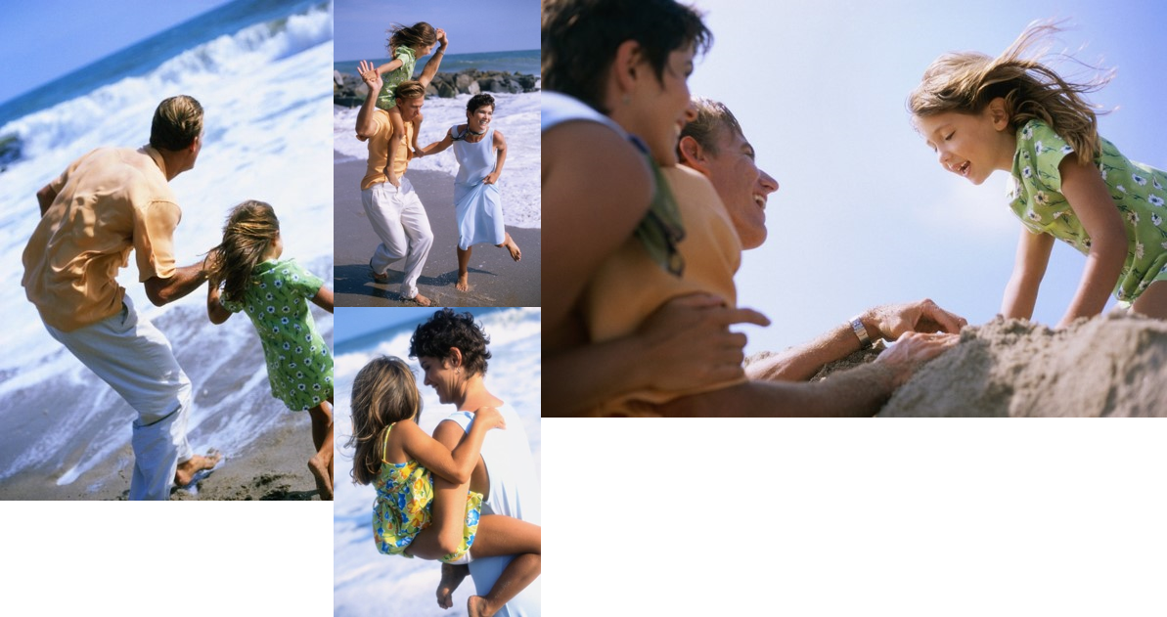
The Bowler’s Hawaiian Adventure
John, Amy and Katie having fun in the sun!

Slide 2
The Process
Plan
Decide “where” to go
Decide “when” to go
Save
Determine how much you need
Start putting it away
Enjoy
Buy the tickets
Sit back and relax

Slide 3
Beach
Shop
Flying a kite
Hat stand
Cruise
Our ship

Slide 4
