Slide 1
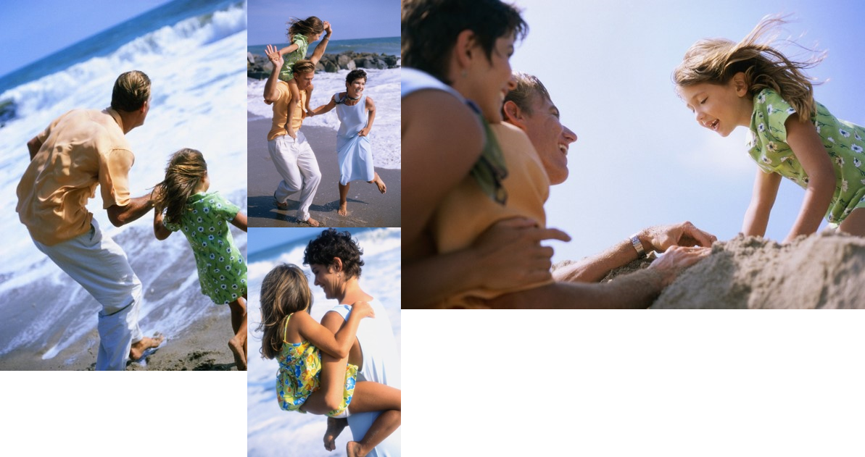
The Bowler’s Hawaiian Adventure
John, Amy and Katie having fun in the sun!

