Slide 1
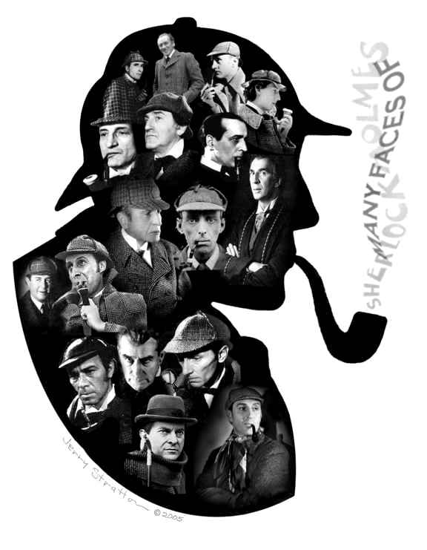
The Legend of Sherlock Holmes

Slide 2
London, 1890s
The world of
Sherlock Holmes

Slide 3
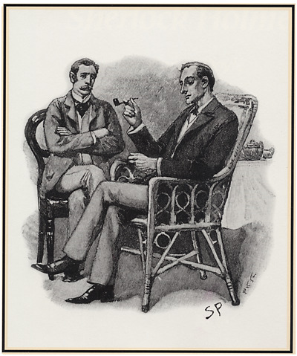
The original stories…
Sir Arthur Conan Doyle
The original Artwork… The Strand Magazine

Slide 4
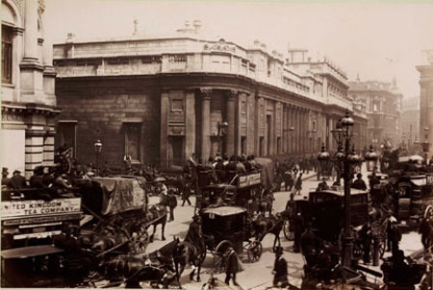
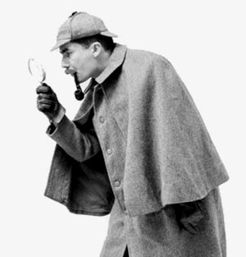

Slide 5
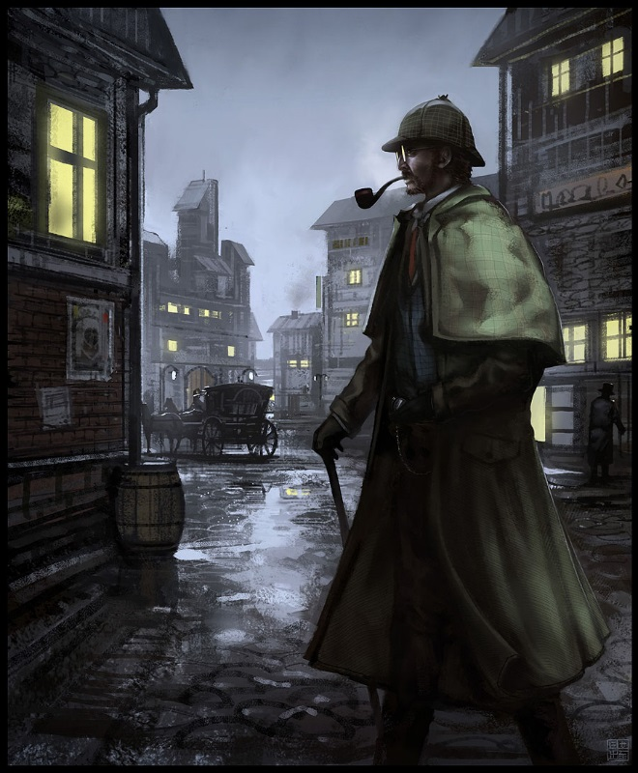
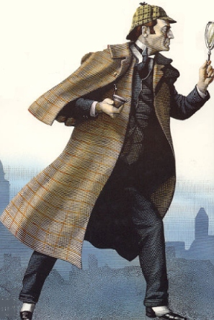
Quite
Elementary
The imagination of one man became…
A new style of police work

