Slide 1
Hawaiian Holiday
My Perspective

Slide 2
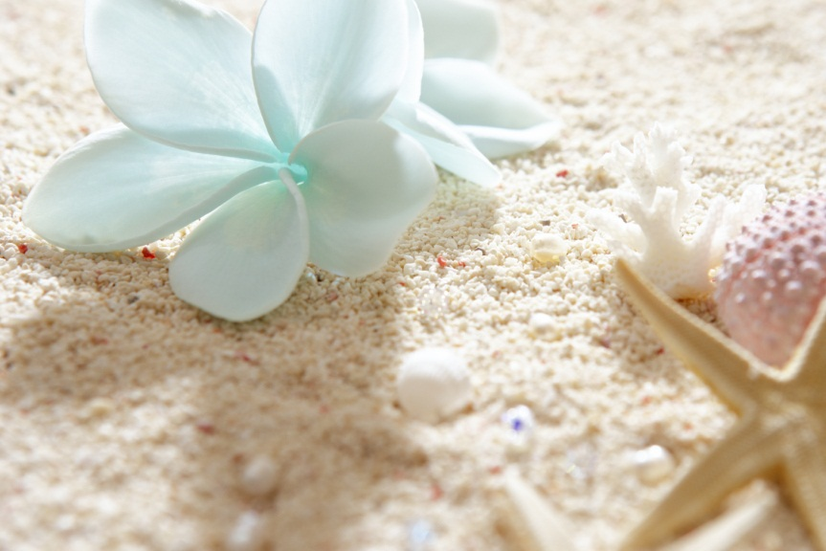
Such a beautiful place

Slide 3
How to get there
Plane
Boat

Slide 4
Why Hawaii?
Sunshine
Water
Warmth
3172 annual hours of sunshine
Pure ocean water
85 degree average temperature

Slide 5
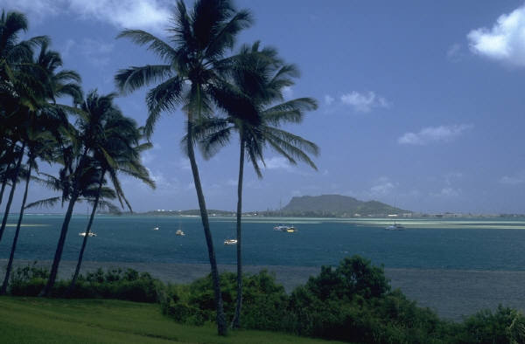
Aloha

