Slide 1
MyTech Instruments
YourName

Slide 2
Types of instruments we sell
Guitars
Bass
Keyboards
Drums
Orchestra

Slide 3
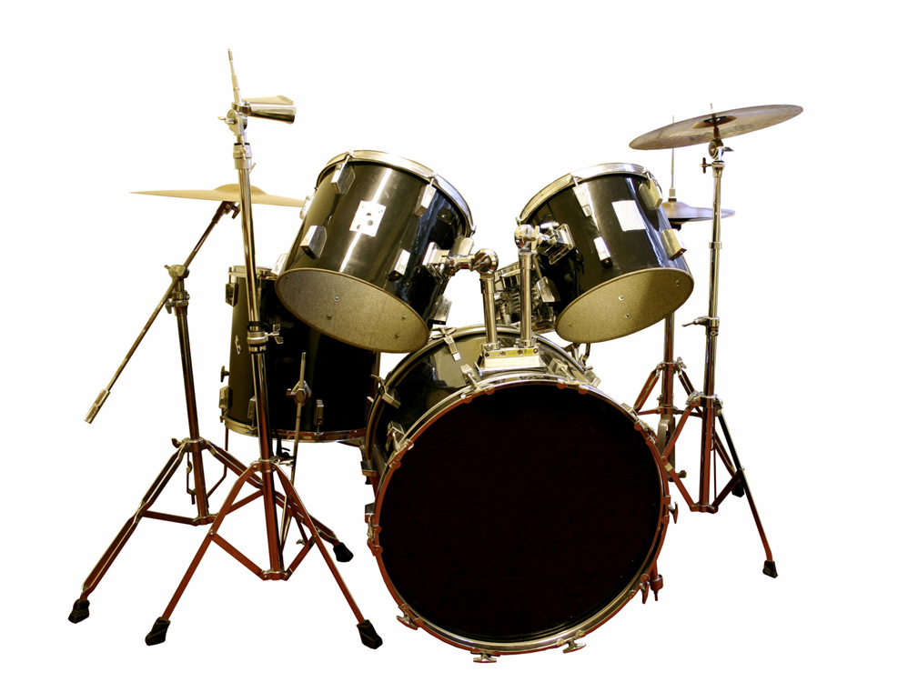
Our specialty
Drums and percussion
Many experts in our store
Offer full sets or components

