Slide 1
Welcome to PowerPoint
What’s in the Window?

Slide 2
Some is the same as Word and Excel

Slide 3
Some is the same as Word and Excel
Similar Controls

Slide 4
Some is the same as Word and Excel
Similar Tabs

Slide 5
Some is different from Word and Excel

Slide 6
Some is different from Word and Excel
Unique Commands

Slide 7
Some is different from Word and Excel
Unique Tabs

Slide 8
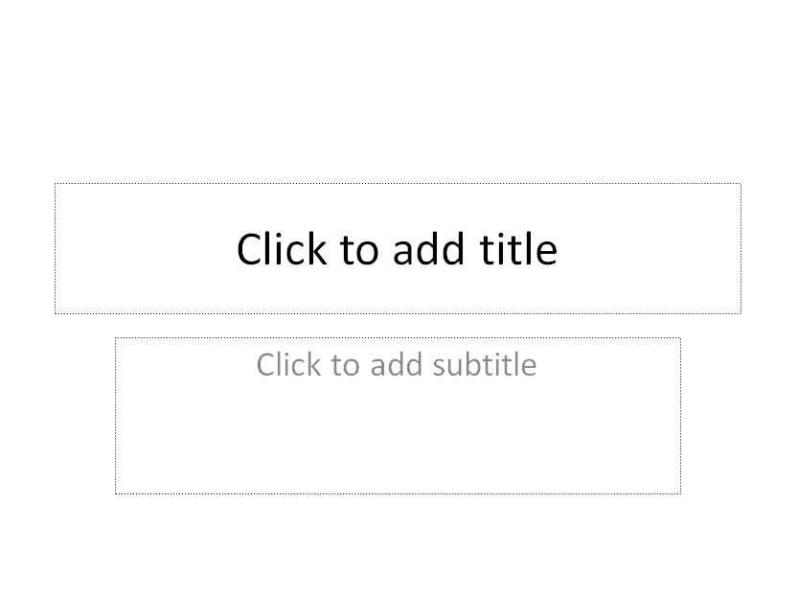
The first slide
To add your own text
Just click and type

Slide 9
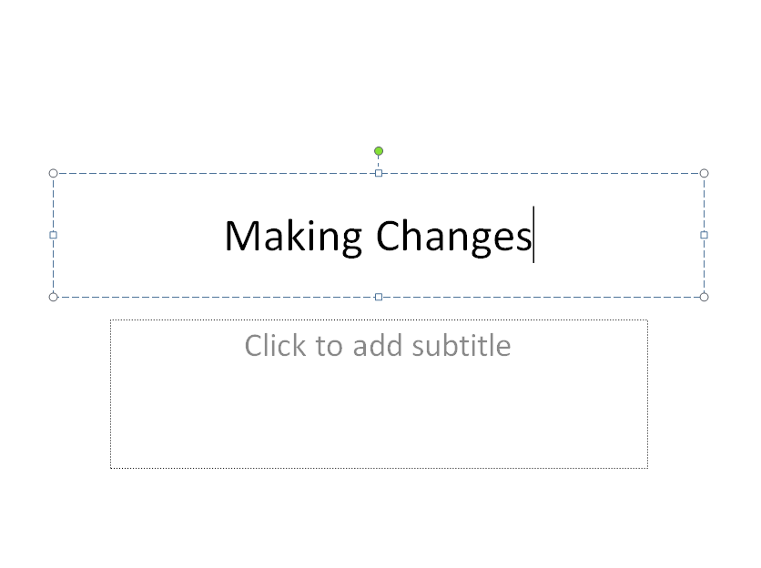
The first slide

Slide 10
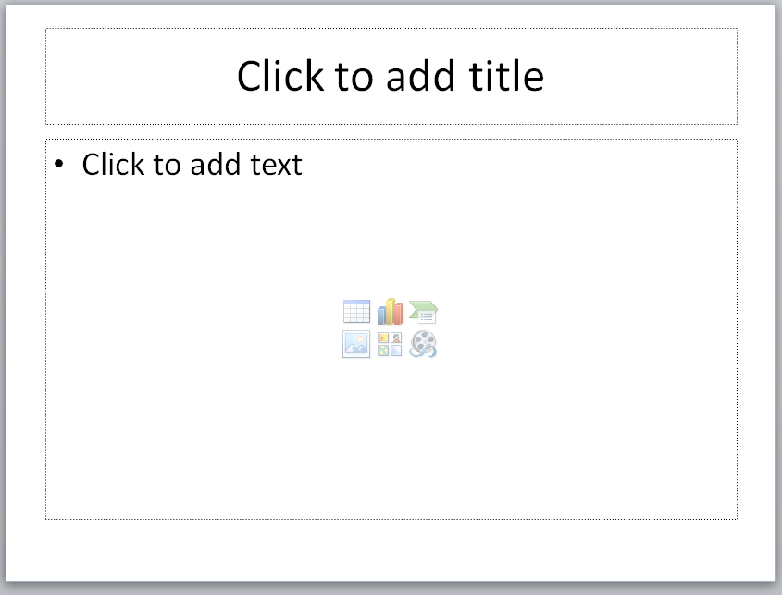
The other slides…

Slide 11
The other slides…

Slide 12
The other slides…

Slide 13
The other slides…
Add what you want:
Lists
Photographs
Cartoons
Video
Audio

Slide 14
Change the background

Slide 15
Change the background

Slide 16
Change the Font

Slide 17
Change the Color

Slide 18
And that’s just the
Beginning

Slide 19
Have some fun

