Slide 1
Wild Man Cycling
Brings out the “wild man” in all of us

Slide 2
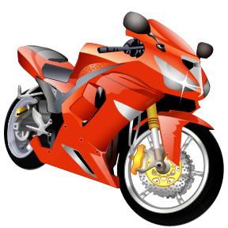
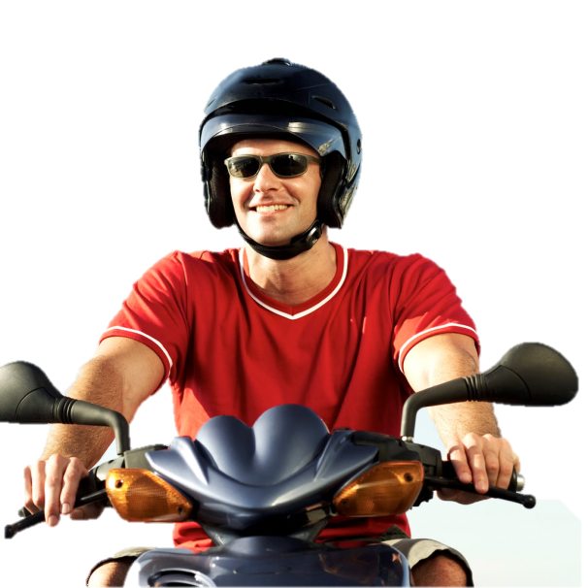
What does your “wild man” want?
Freedom
Power

Slide 3
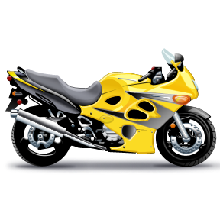
Check out the showroom
Online
From our brochure
In person

Slide 4
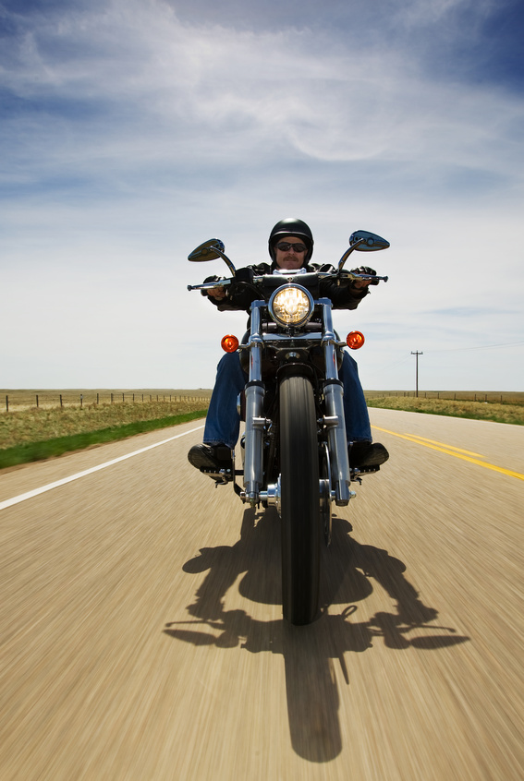
Get your motor running…

Slide 5
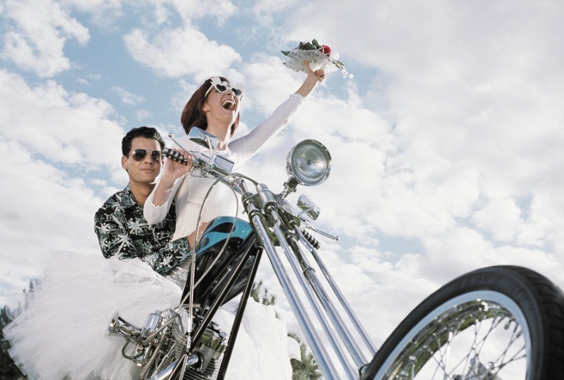

Slide 6
For the “wild man” in all of us
Wild Man Cycling www.wildmancycling.com

