Slide 1
Handover Real Estate
Our name and our promise
Handover Real Estate Ltd.
Notes:
Hello, everyone. I am glad to present a local real estate company that can make your buying and selling a house as easy as 1-2-3.

Slide 2
Laura and Turner Handover
Husband & wife team
Over 30 years experience
Raised in Ventula Valley
3-time Agents of the year
2 Agents for the price of 1
Handover Real Estate Ltd.

Slide 3
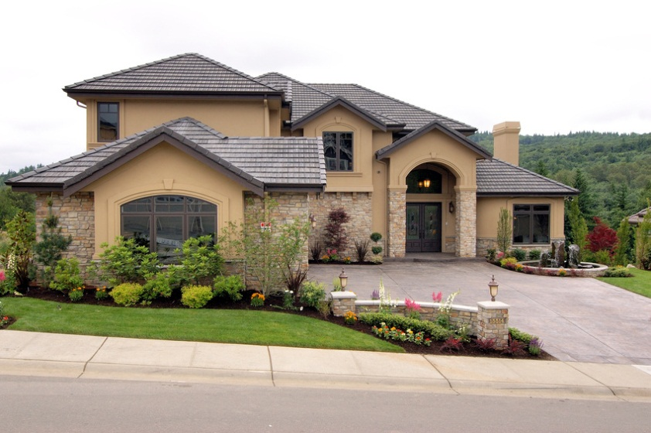
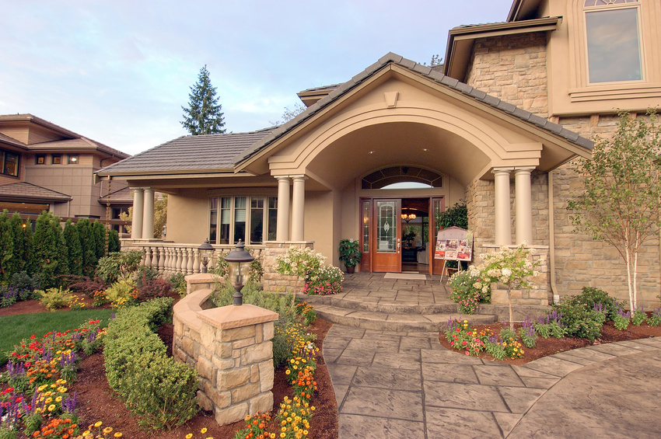
The Ventula Valley
Handover Real Estate Ltd.
Notes:
Not only were Lara and Turner raise in the Ventula Valley, but they still live here. They consider you as much more than clients—you are neighbors.

Slide 4
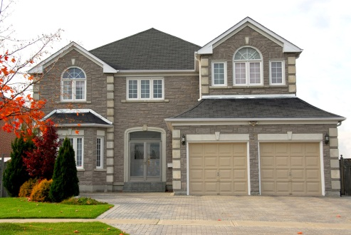
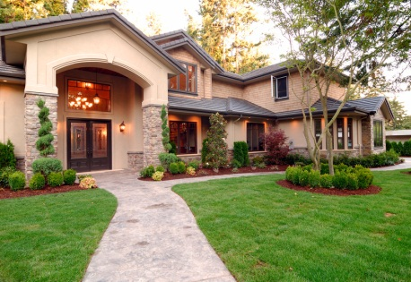
Home Value in Ventula Valley
Handover Real Estate Ltd.

Slide 5
Easy as 1-2-3
When the time comes to move:
Call Handover Real Estate
Pick your new home
Start packing
Handover Real Estate Ltd.
Notes:
When you know for certain that it’s time to move into or within the Ventula Valley, Let Handover Real Estate make it as easy as 1-2-3. Call them. They will help you pick out your new home. Then start packing because you’re about to move.

Slide 6
Can we Handover your new home?
Handover Real Estate Ltd.
Notes:
Lara and Turner are asking you: Can we Handover your new home? Call them anytime, toll-free at triple 8, triple 5, 73-55. And leave the rest to them.

