Slide 1
Elements of Photography

Slide 2
There are 10 main elements of photography
SPACE
LINE
LIGHT &
SHADOWS
DEPTH OF FIELD
FRAMING
PATTERN
COLOR
SHAPE
TEXTURE
ANGLE

Slide 3
Line
Lead the viewer’s eye
Can be straight or organic
Diagonal lines create movement
Look for lines created by repeating objects or shadows.

Slide 4
Line

Slide 5
Line
BACK

Slide 6
Shape
Flat outlines or 3-D forms
Can create a frame around a subject
Look for shapes in repetition

Slide 7
Shape
BACK

Slide 8
Framing
Look for objects to create a frame around your subject

Slide 9
Framing
BACK

Slide 10
Light & Shadows
Notice how the light changes objects by creating shadows

Slide 11
Light & Shadows

Slide 12
Silhouette
By putting a subject in front of a lightsource, the subject becomes a dark shape called a silhouette.
BACK

Slide 13
Texture
The details on the surface of objects

Slide 14
Texture

Slide 15
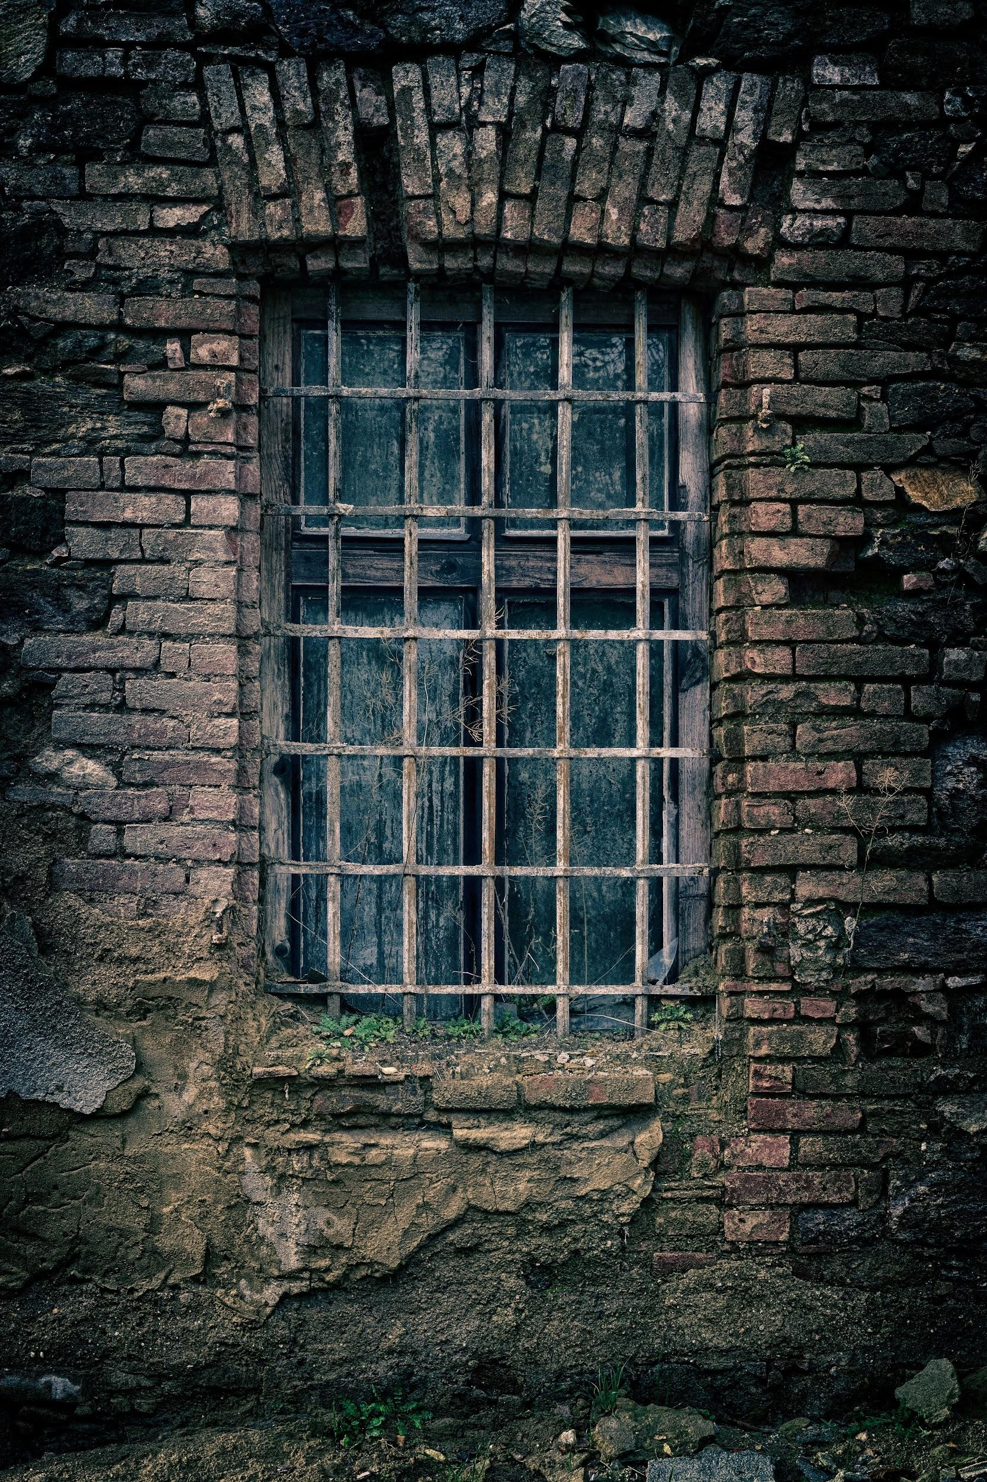
Texture
BACK

Slide 16
Pattern
Look for repetition of different elements, such as shapes, lines, or forms creating Patterns.
Get closer or further away to see new patterns

Slide 17
Pattern

Slide 18
Pattern
BACK

Slide 19
Space
Look for the empty spaces around objects.
An interesting background can add interest to your photographs

Slide 20
Space
BACK

Slide 21
Color
Colors can be bright and bold, subtle, or black and white.
Look how the colors of your subject interact with the colors of your subject.

Slide 22
Color

Slide 23
Color
BACK

Slide 24
Depth of Field
Shallow depth of field- highlights the subject and makes it stand out from a busy background
Wide depth of field- leads the eye all through the image. Everything is in focus.

Slide 25
Shallow Depth of Field Wide Depth of Field
BACK

Slide 26
Angle/ Perspective
The photographer takes the image from either lower or higher than eye level.

Slide 27
Perspective- Low

Slide 28
Perspective- High
BACK

