Slide 1
Psychology of Color
Important to Consider in Logo Creation

Slide 2
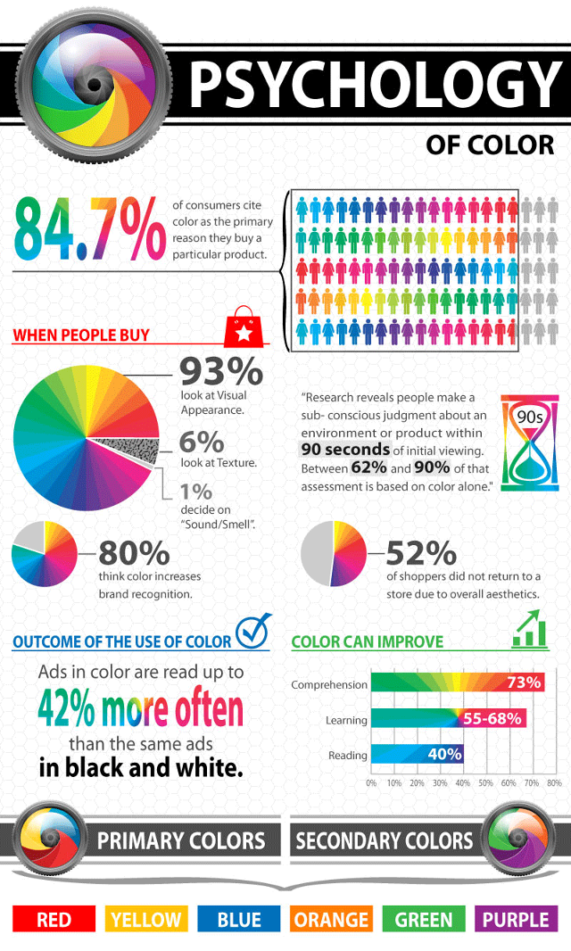

Slide 4
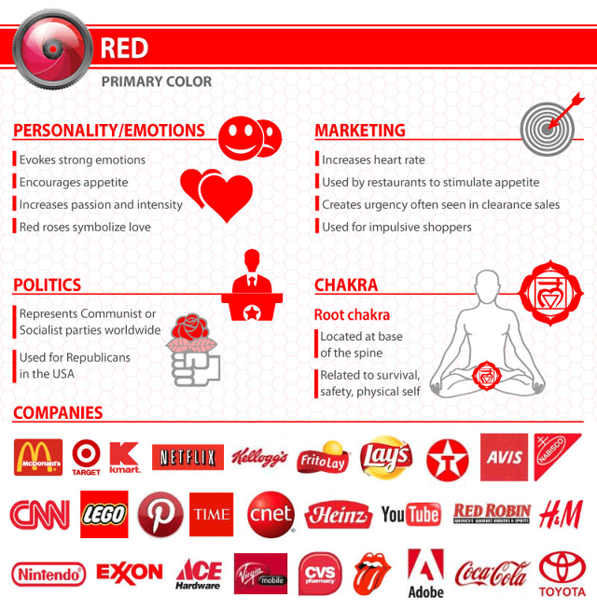
Notes:
Red is often associated with the heat of sun and fire and is considered a high-arousal color, often stimulating people to take risks, according to color think tank, Pantone. It has also been shown to stimulate the senses and raise blood pressure, and it may arouse feelings of power, energy, passion, love, aggression, or danger.

Slide 5
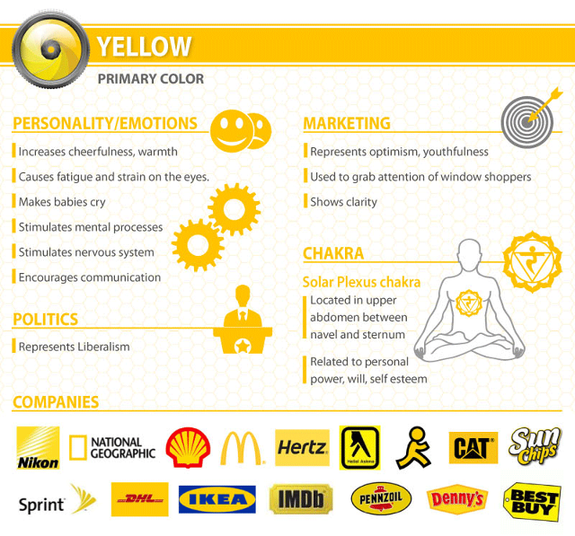
Notes:
Yellow is often associated with the heat of sun and fire and is considered a high-arousal color. It may stimulate feelings of optimism and hope or cowardice and betrayal.

Slide 6
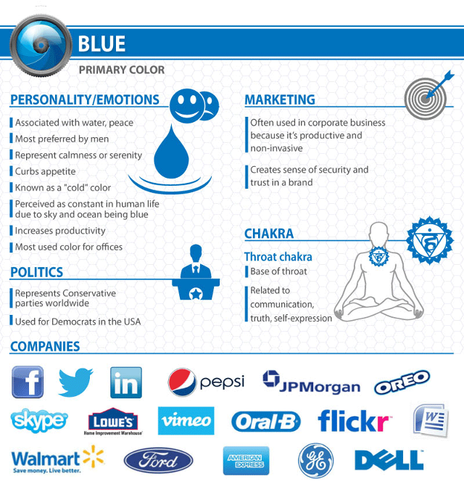
Notes:
Blue is often associated with the coolness of the sea and sky. It has been shown to calm the senses and lower blood pressure. It may stimulate feelings of trust, security, order, and cleanliness.

Slide 7
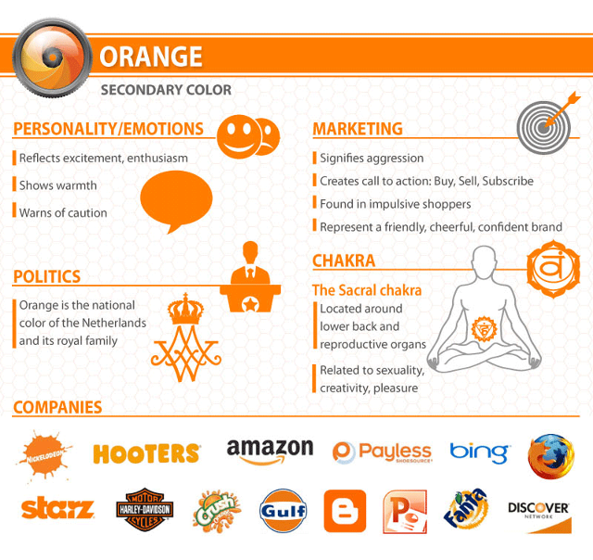
Notes:
Orange is often associated with the heat of sun and fire and is considered a high-arousal color. It may stimulate feelings of energy, balance, and warmth.

Slide 8
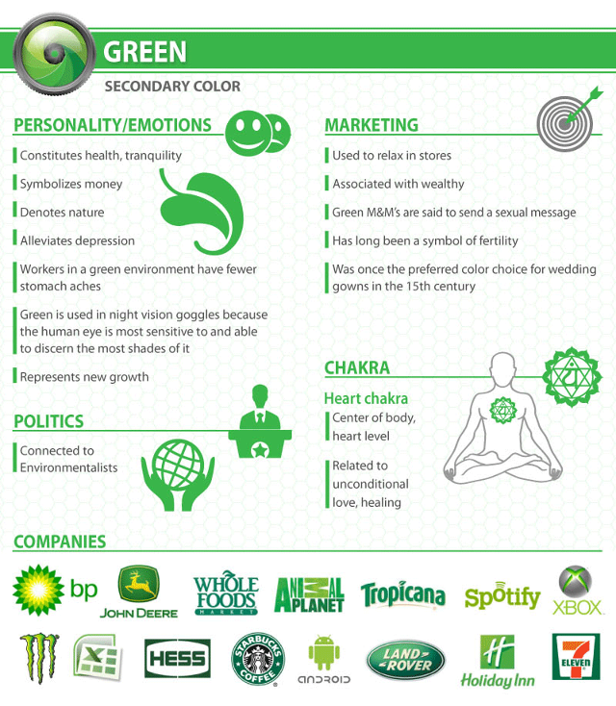
Notes:
Green is often associated with the coolness of leaves. People often associate it with nature, health, good luck, and jealousy.

Slide 9
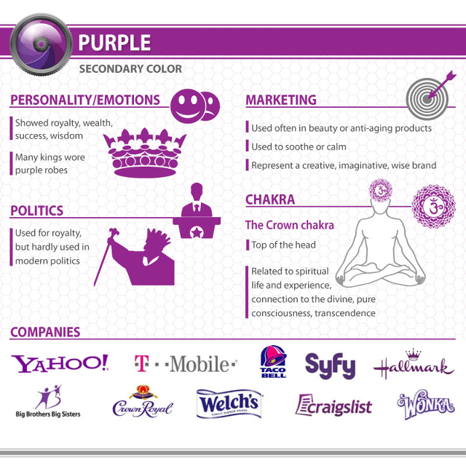
Notes:
Purple is generally considered a low-arousal color. It may stimulate feelings of spirituality, mystery, royalty, or arrogance.

