Slide 1
1st-2nd Grade Computers
Mrs. Nightingale

Slide 2
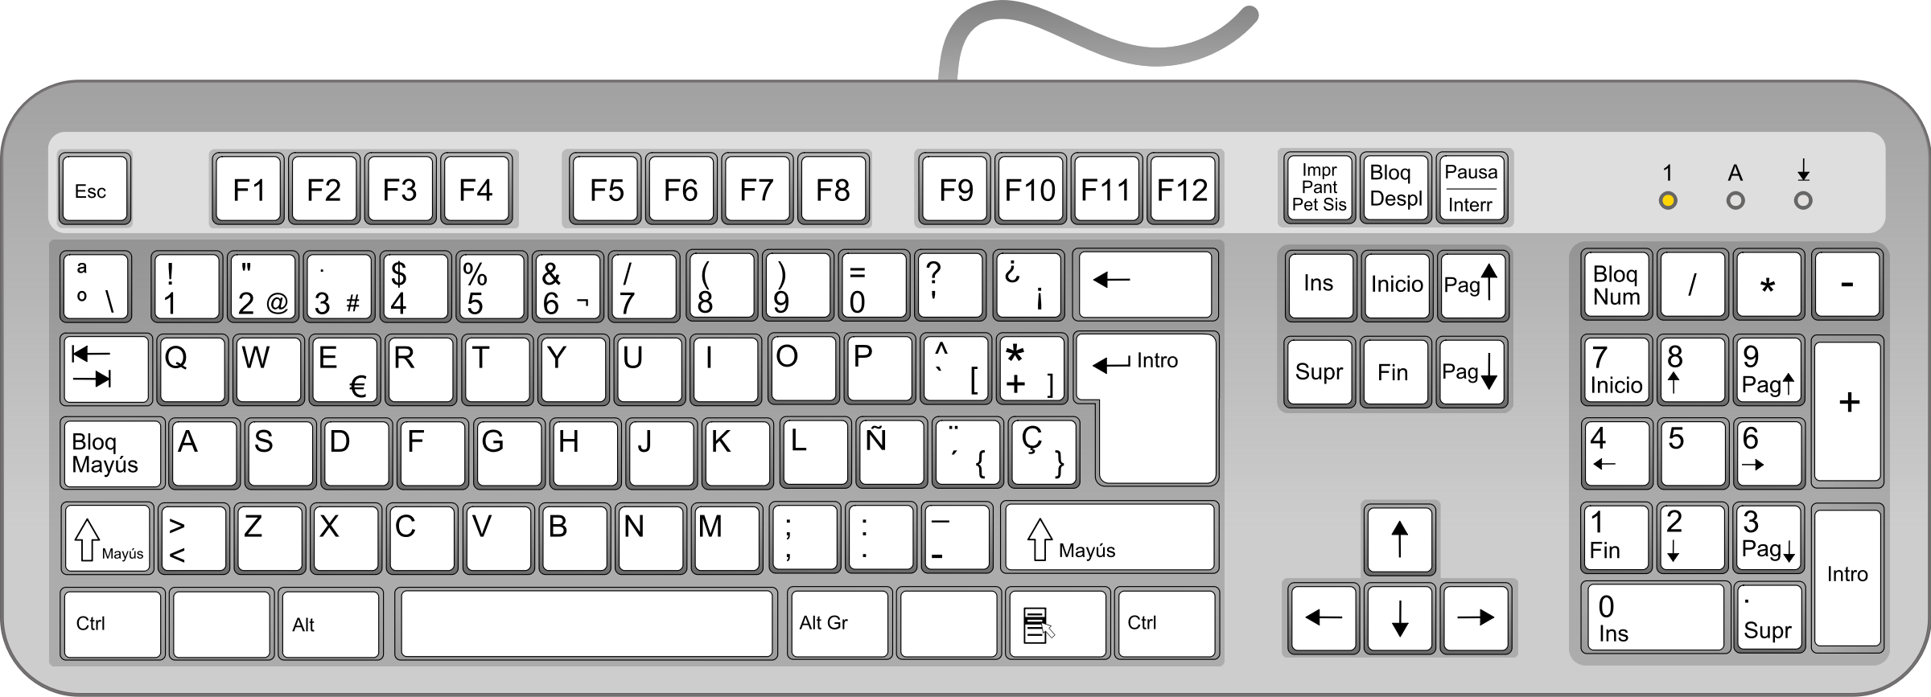
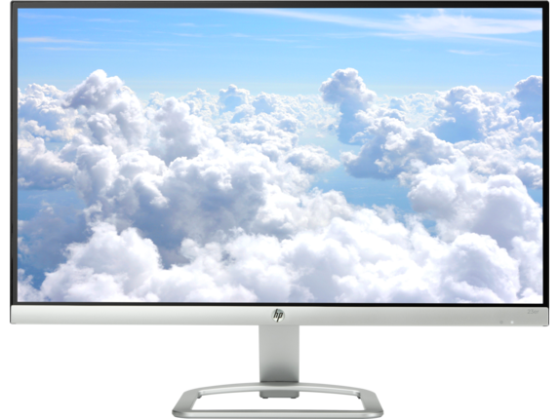
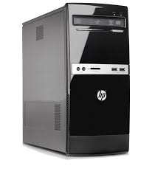
Computer Parts
Keyboard
Mouse
Monitor
CPU

Slide 3
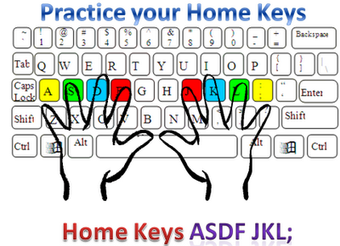
Keyboarding
Home Row

