Slide 1
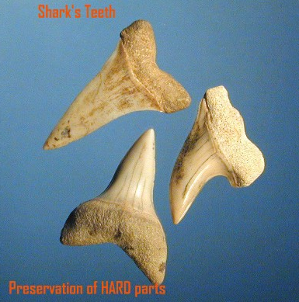
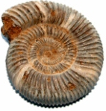
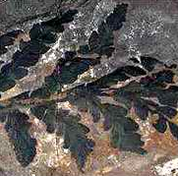
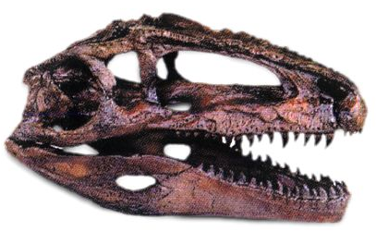
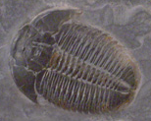
Fossils
Notes:
*

Slide 2
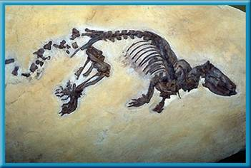
Fossil: The remains, imprints or traces of prehistoric organisms that are preserved in rock.
Fossils are evidence of not only when and where organisms once lived, but also how they lived.
Notes:
*

Slide 3
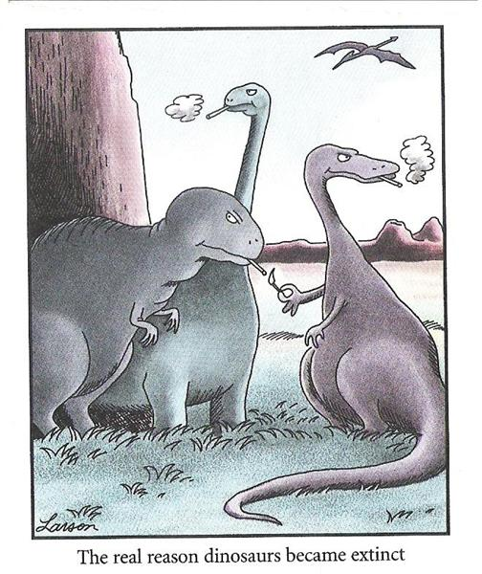

Slide 4
What is a fossil?
A fossil is the preserved remains of a once-living organism.
What do fossils tell us?
Fossils give clues about organisms that lived long ago.
They also provide evidence about how Earth’s surface has changed over time.
Fossils help scientists understand what past environments may have been like.
Notes:
*

Slide 5
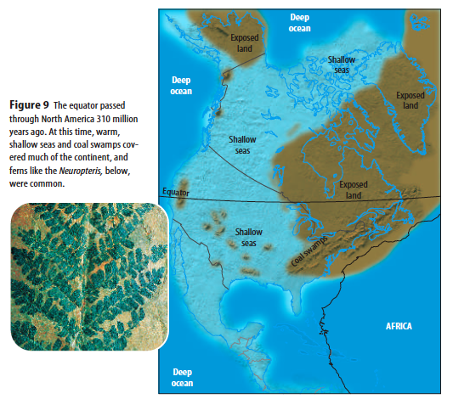

Slide 6
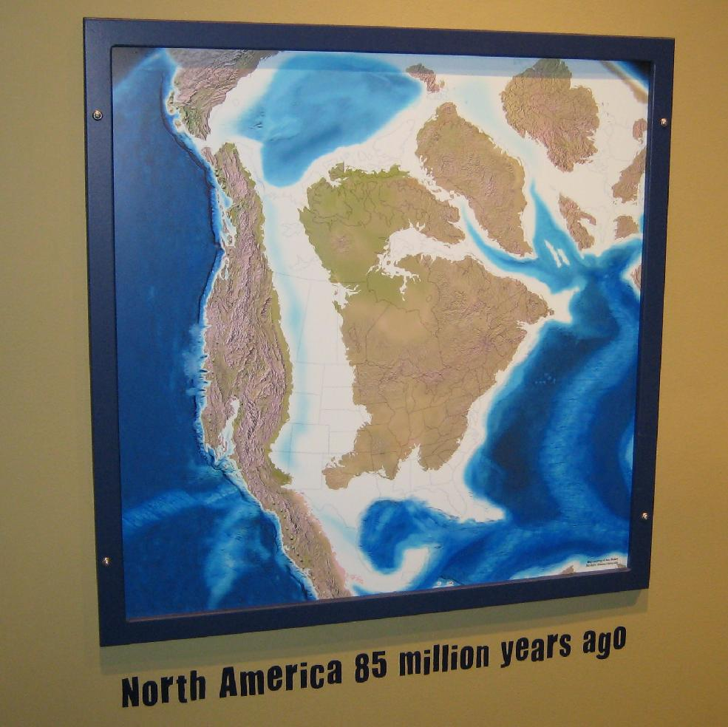
Notes:
*

Slide 7
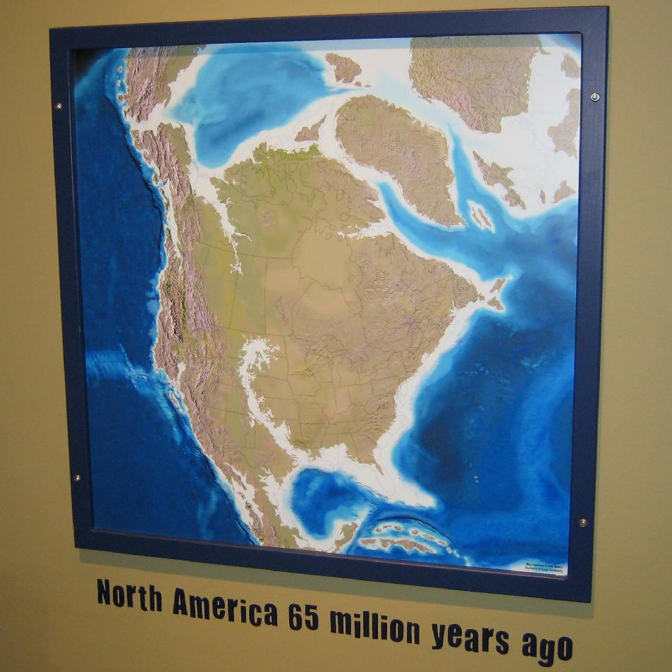
Notes:
*

Slide 8
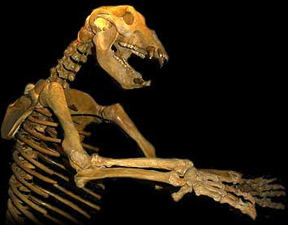
Fossils are rare because very “lucky” conditions are needed to create them:
The dead organism must be protected from scavengers, microorganisms and the processes of weathering (usually this means the body is quickly covered by sediments)
Notes:
*

Slide 9
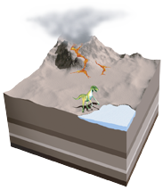
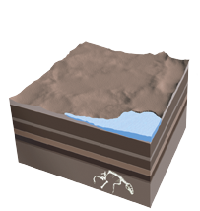
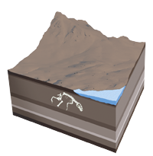
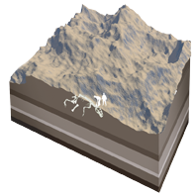
HOW IS A FOSSIL FORMED?
1. Sediment
An animal is buried by sediment, such as volcanic ash or silt, shortly after it dies. Its bones are protected from rotting by the layer of sediment.
2. Layers
More sediment layers accumulate above the animal’s remains, and minerals, such as silica (a compound of silicon and oxygen), slowly replace the calcium phosphate in the bones.
3. Movement
Movement of tectonic plates, or giant rock slabs that make up Earth’s surface, lifts up the sediments and pushes the fossil closer to the surface.
4. Erosion
Erosion from rain, rivers, and wind wears away the remaining rock layers. Eventually, erosion or people digging for fossils will expose the preserved remains.
Notes:
*

Slide 10
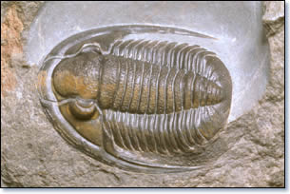
A fossil is more likely to form if the
organism had hard parts like bones, shells or teeth.
Notes:
*

Slide 11
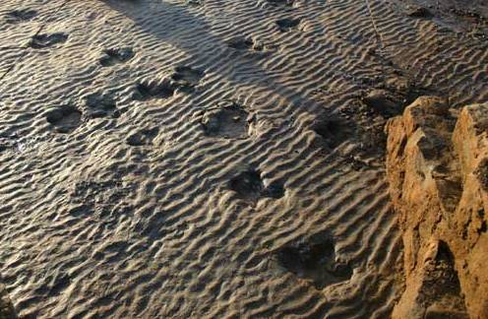
Fossils are generally only found in sedimentary rocks because the heat/pressure involved in forming igneous and metamorphic rocks would destroy the organism.
Notes:
*

Slide 12
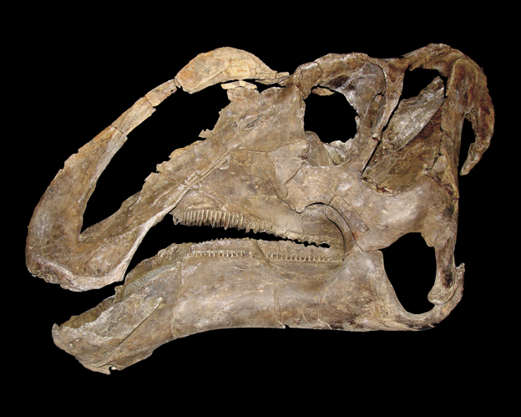
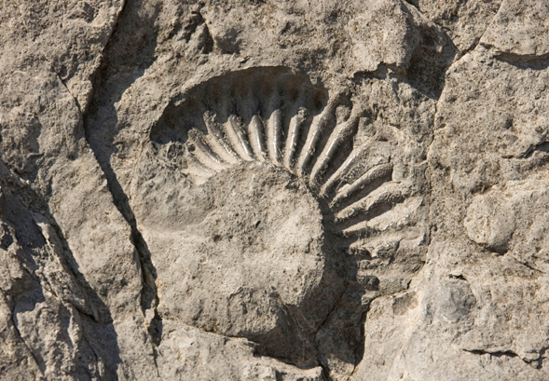
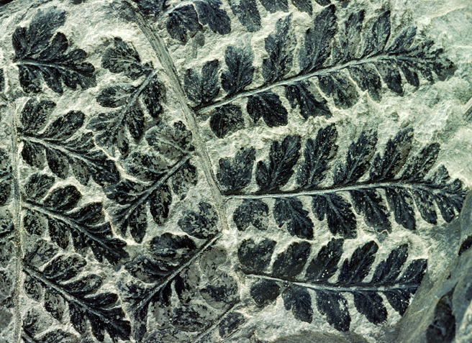
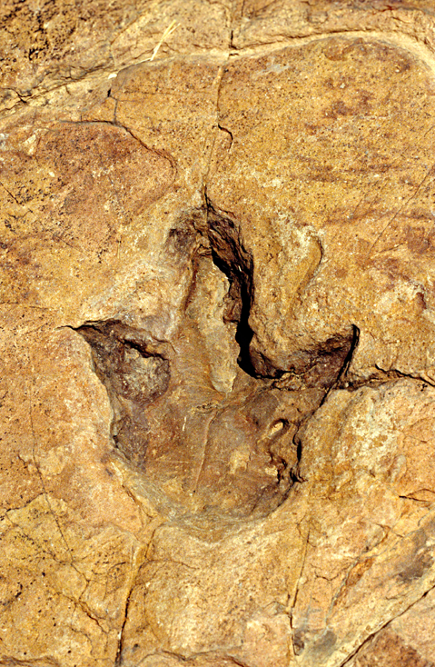
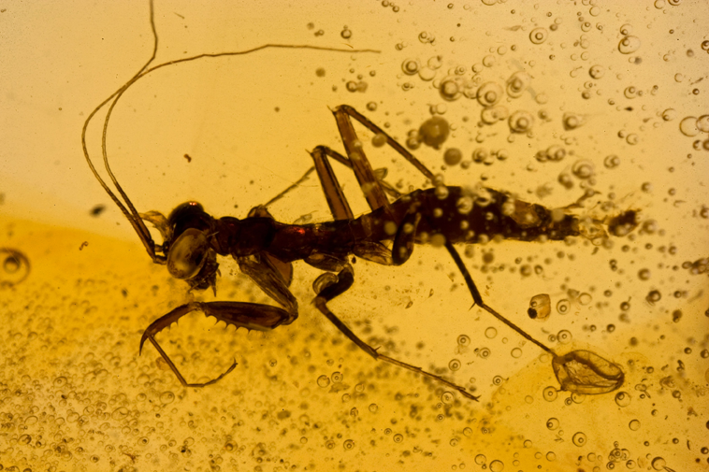
FIVE MAIN TYPES OF FOSSILS
Petrified
Fossils
Molds and
Casts
Carbon Films
Trace
Fossils
Preserved
Remains
Notes:
*

Slide 13
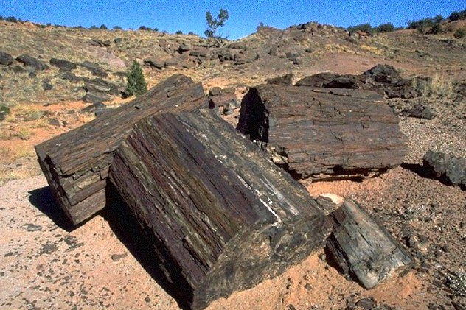
1. Permineralized (Petrified) Remains: are hard and rock-like because the original material has been replaced by minerals
Notes:
*

Slide 14
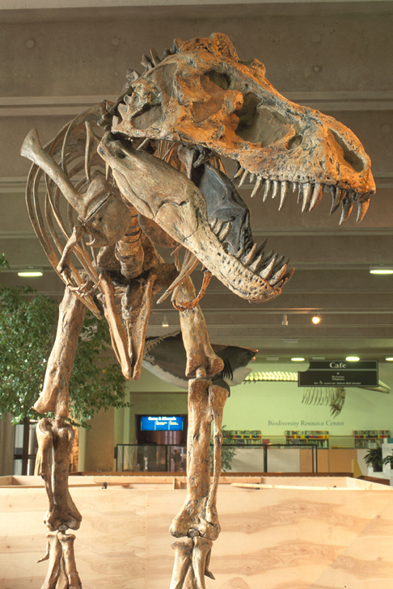
PETRIFIED FOSSILS
The word “petrified” means “turning into stone.”
Petrified fossils form when minerals replace all or part of an organism.
Water is full of dissolved minerals. It seeps through the layers of sediment to reach the dead organism. When the water evaporates, only the hardened minerals are left behind.
PETRIFIED FOSSIL The Field Museum in Chicago displays a fossil of a Tyrannosaurus rex.
Notes:
*

Slide 15
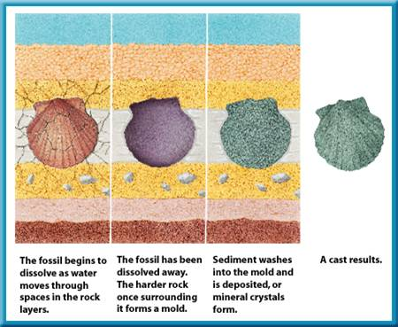
2. Molds/Casts: An object gets buried, then decays leaving behind a space called a mold. The mold gets filled in by other sediments which harden into rock and forms a cast of the original object
Notes:
*

Slide 16
MOLDS AND CASTS
A mold forms when hard parts of an organism are buried in sediment, such as sand, silt, or clay.
The hard parts completely dissolve over time, leaving behind a hollow area with the organism’s shape.
MOLD FOSSIL
This mold, or imprint, is of an extinct mollusk called an ammonite.
A cast forms as the result of a mold.
Water with dissolved minerals and sediment fills the mold’s empty spaces.
Minerals and sediment that are left in the mold make a cast.
A cast is the opposite of its mold.
CAST FOSSIL This ammonite cast was discovered in the United Kingdom.
Notes:
*

Slide 17
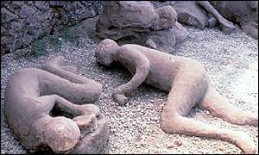
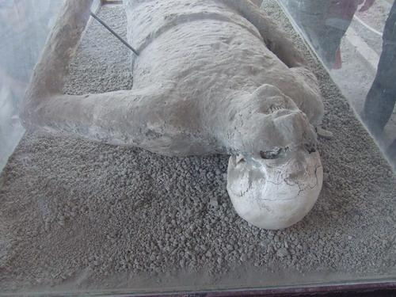
Notes:
*

Slide 18
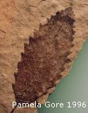
3. Carbon Films: are when the organism gets pressed against a hard object and leaves behind a thin film of carbon residue (similar to a fingerprint)
Notes:
*

Slide 19
CARBON FILMS
All living things contain an element called carbon.
When an organism dies and is buried in sediment, the materials that make up the organism break down.
Eventually, only carbon remains.
The thin layer of carbon left behind can show an organism’s delicate parts, like leaves on a plant.
FERN FOSSIL This carbon-film fossil of a fern is more than 300 million years old.
Notes:
*

Slide 20
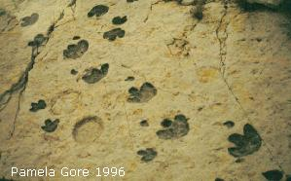
4. Trace Fossils: Tracks that have been preserved in mud/clay (similar to hand prints in cement)
Notes:
*

Slide 21
TRACE FOSSILS
Trace fossils show the activities of organisms.
An animal makes a footprint when it steps in sand or mud.
Over time the footprint is buried in layers of sediment. Then, the sediment becomes solid rock.
FANCY FOOTWORK This dinosaur footprint was found in Namibia, Africa.
Notes:
*

Slide 22
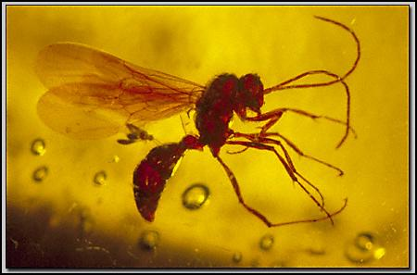
5. Original or Preserved Remains: The actual organism or part of it has been preserved in amber, ice or tar (usually very rare and valuable)
Notes:
*

Slide 23
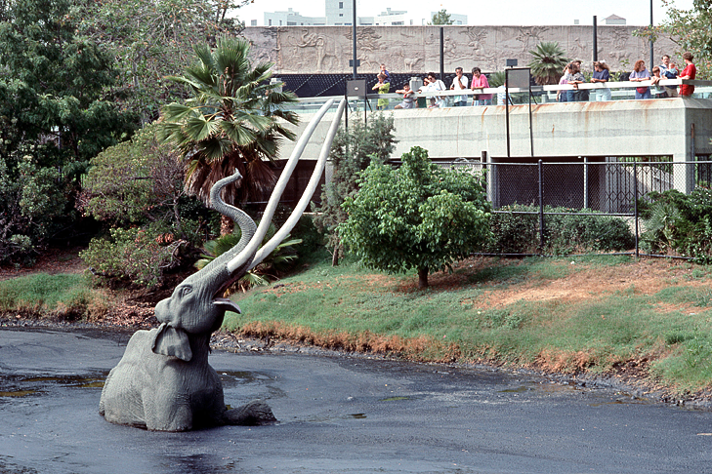
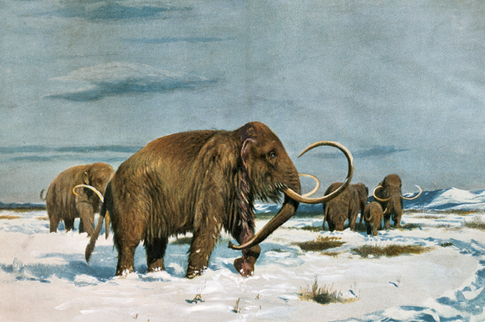
PRESERVED REMAINS
Some organisms get preserved in or close to their original states. Here are some ways that can happen.
Amber An organism, such as an insect, is trapped in a tree’s sticky resin and dies. More resin covers it, sealing the insect inside. It hardens into amber.
Tar An organism, such as a mammoth, is trapped in a tar pit and dies. The tar soaks into its bones and stops the bones from decaying.
Ice An organism, such as a woolly mammoth, dies in a very cold region. Its body is frozen in ice, which preserves the organism—even its hair!
Notes:
*

